Slide 1
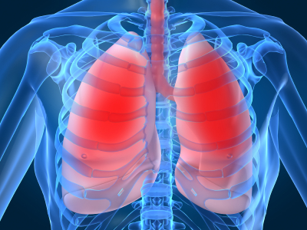
LECTURE NO (6)
Respiratory Physiology Bader Hassan
Lecturer Of Physiology
Control
of
respiration
Faculty Of Medicine Dept.Of Physiology

Slide 2
Control of respiration
Can be studied as:-
Neural control.
Chemical control.
The neural control includes 2 types:
Involuntary control (via the respiratory center).
Voluntary control (via the cerebral cortex).

Slide 3
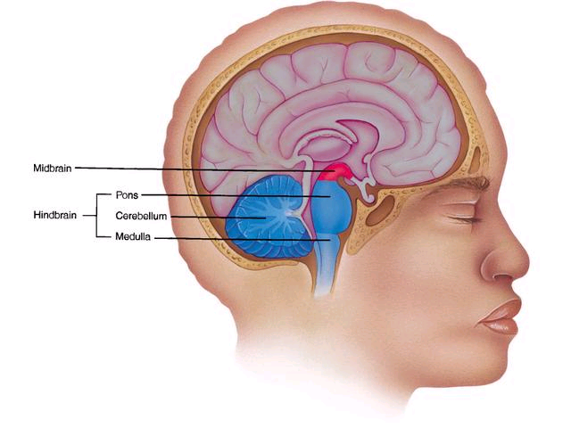

Slide 4
Respiratory center
Found in the brain stem (in the medulla & pons).
It discharges impulses rhythmically to cause respiration.
Factors that affect the respiratory center and modify respiration include:
The cerebral cortex: responsible for voluntary control.
The hypothalamus: ↑respiration when the body temperature rises.

Slide 5
Baroreceptors: ↓ respiration when the blood pressure rises.
Chemoreceptors: responsible for the chemical control.
Proprioceptors: ↑ respiration during exercise.

Slide 6
Cerebral cortex
Voluntary Control
Emotion
Temperature
Hypothalamus
Pons
Respiratory center
Medulla
Rhythm generator
Cervical spinal cord

Slide 7
Chemical control of breathing
The chemical control occurs through stimulation of chemoreceptors that detect chemical changes in the blood or CSF.
Chemoreceptors are divided into:
Peripheral chemoreceptors:
Found in the aortic bodies & carotid bodies.
Stimulated mainly by hypoxia & also by ↑hydrogen ion (acidosis) and ↑ CO2.

Slide 8
They send excitatory impulses to stimulate the respiratory center.
This result in hyperventilation to correct the stimulus.

Slide 9
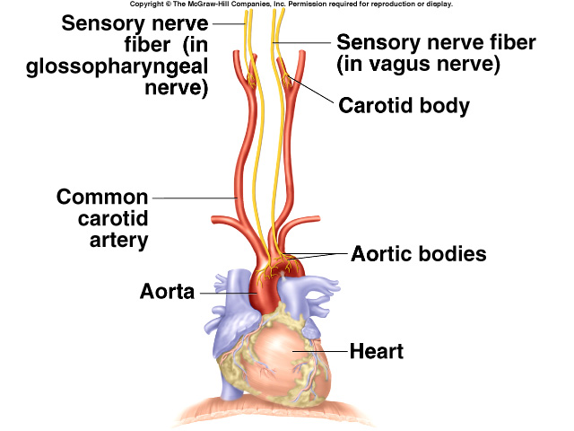

Slide 10
Peripheral
chemoreceptors
Peripheral
chemoreceptor
Low PO2
stimulate
PO2 returned
to normal
stimulate
PO2 is returned
to normal
ventilation
Respiratory center
increase
Effect of O2 lack on ventilation

Slide 11
The central chemoreceptors:
Found on the surface of the medulla.
Stimulated by:
High carbon dioxide (↑CO2).
High hydrogen ion (in the CSF).
Hydrogen ion in the blood can not cross the blood brain barrier (BBB).
Hydrogen ions in the CSF are formed from CO2 .

Slide 12
CO2 can cross the BBB & react with water in the CSF to produce carbonic acid & then bicarbonate & hydrogen ions.
Hydrogen ions then stimulate the central chemoreceptors.
This mean that CO2 stimulate the central chemoreceptors directly & indirectly.

Slide 13
CSF
↑ CSF CO2
Rise in PCO2
CO2 diffuses
increase
PO2 returned
to normal
PCO2 is reduced
to normal
CSF {H+}
stimulate
Central
chemoreceptors
ventilation
stimulate
increase
Respiratory center
Effect of increase in CO2 on ventilation

Slide 14
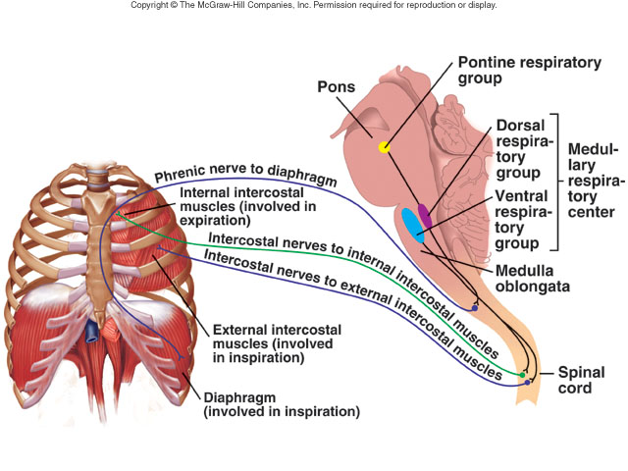

Slide 15

Thank you

